Slide 1
Project: LIGHTING CONTROL SYSTEM
CET K19
Senior Project 2
Major: Computer Engineering Technology
Supervisor: M.E. Le Minh
Students: Nguyen Gia Hung-19119052
Nguyen Van Quang Huy-19119030
INDEX.HTML

Slide 2

Lighting Control System
CET K19
1. Introduction
2. System model
3. System design
4. Result
5. Conclusion and future work
INDEX.HTML

Slide 3

Introduction
CET K19
Today with the strong development of the 4.0 technology era, the development of IoT systems formed such as smart houses, smart cities, and smart farms,…
To approach the IoT model and learn the basic knowledge of this technology and to provide people with a system that helps them can control the devices remotely.
Our group decided to build “A Lighting Control System” which uses IoT technology as the foundation.
INDEX.HTML

Slide 4
Lighting Control System
CET K19
1. Introduction
2. System model
3. System design
4. Result
5. Conclusion and future work
INDEX.HTML

Slide 5
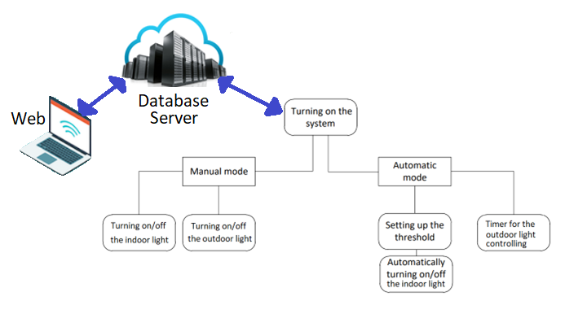
System model
CET K19

Slide 6
Lighting Control System
CET K19
1. Introduction
2. System model
3. System design
4. Result
5. Conclusion and future work
INDEX.HTML

Slide 7
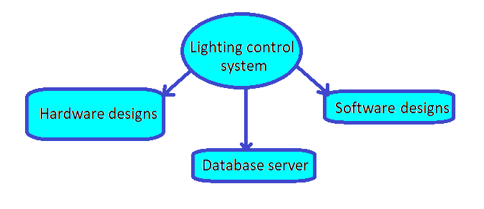
System Design
CET K19
INDEX.HTML

Slide 8
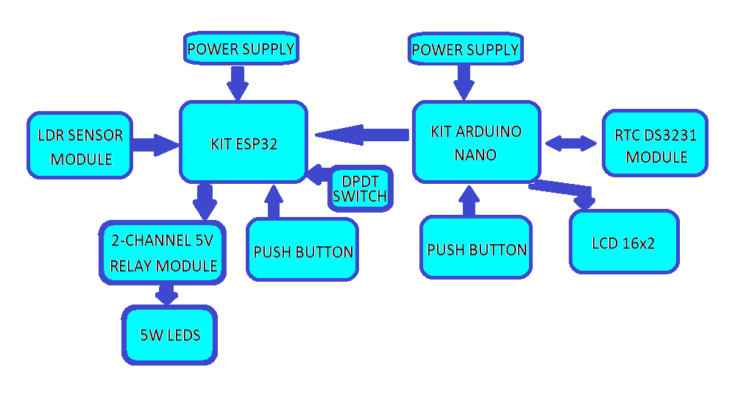
System Design
CET K19
Hardware designs
Block diagram
INDEX.HTML

Slide 9
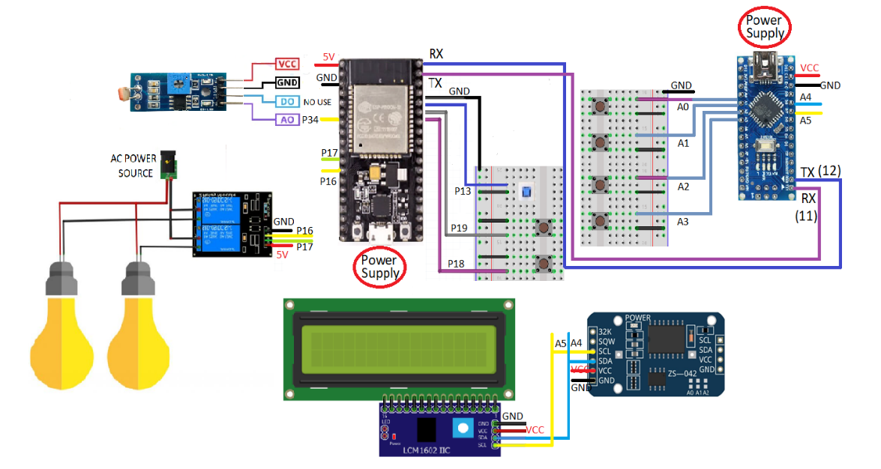
System Design
CET K19
Hardware designs
Connection diagram
INDEX.HTML

Slide 10
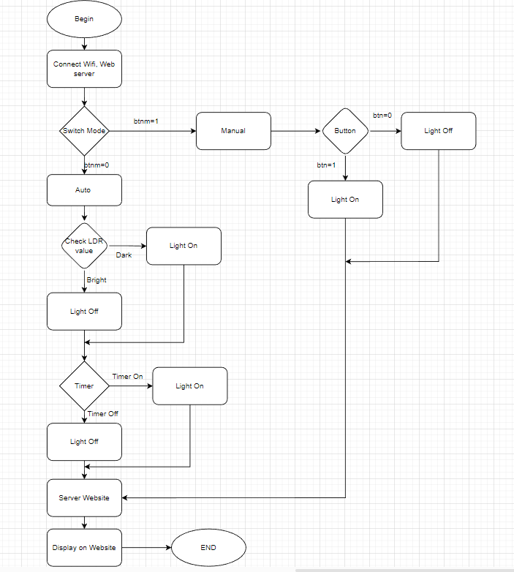
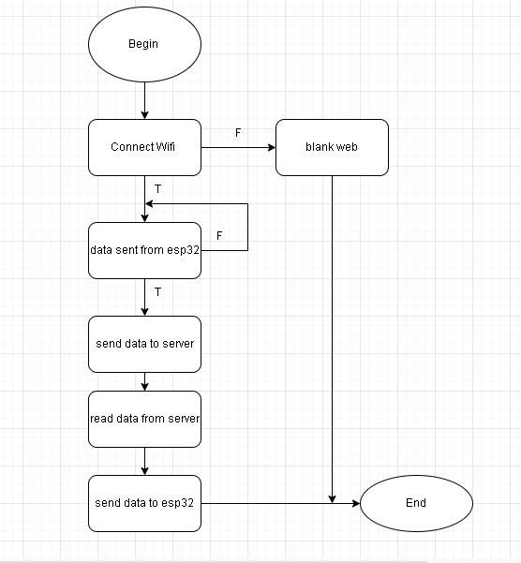
System Design
CET K19
Software designs
Algorithm flowchart of the system
Network communication block flowchart
INDEX.HTML

Slide 11

System Design
CET K19
Server
Real-time data storage
Link firebase to website
Link firebase to esp32
INDEX.HTML

Slide 12
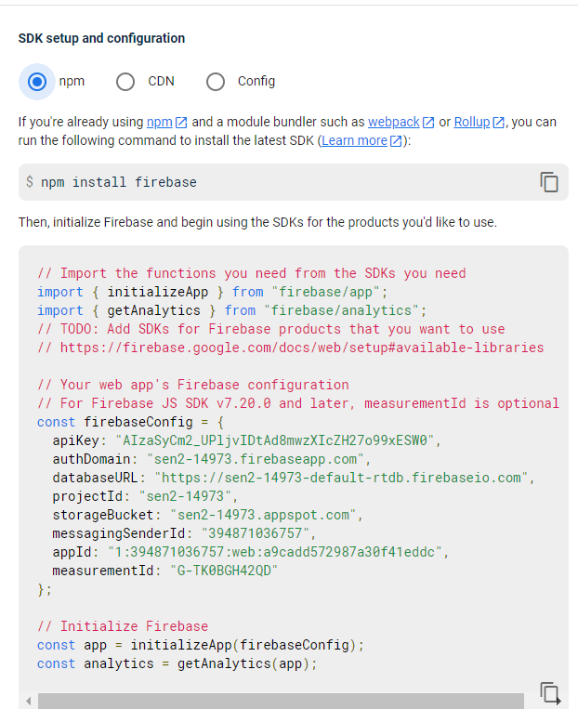
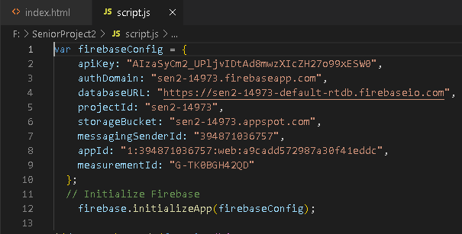
Link firebase to Website
CET K19
Copy the command line in firebase to source web
INDEX.HTML

Slide 13
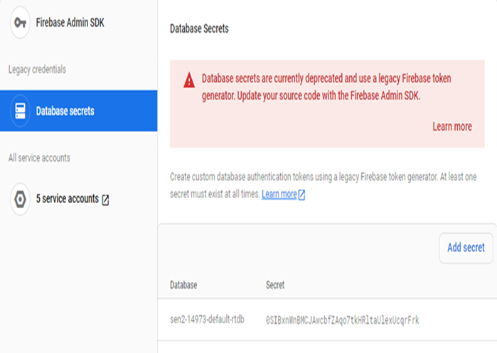
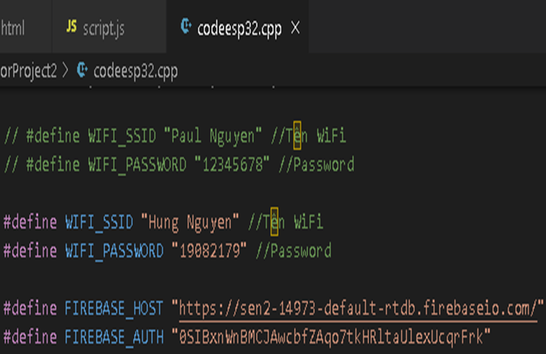
Link firebase to ESP32
CET K19
Copy secret code from firebase into source code of ESP32
INDEX.HTML

Slide 14
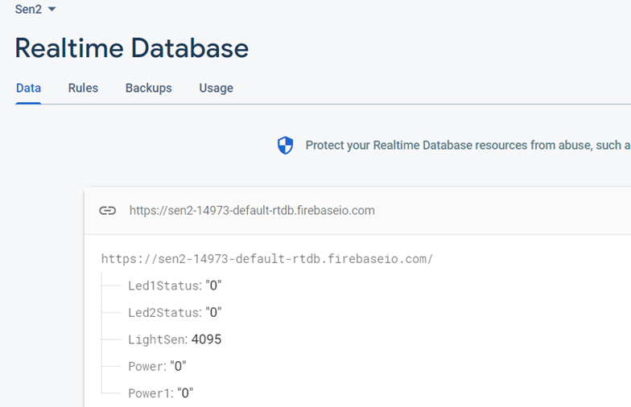
Server
CET K19
Copy secret code from firebase into source code of ESP32
INDEX.HTML

Slide 15
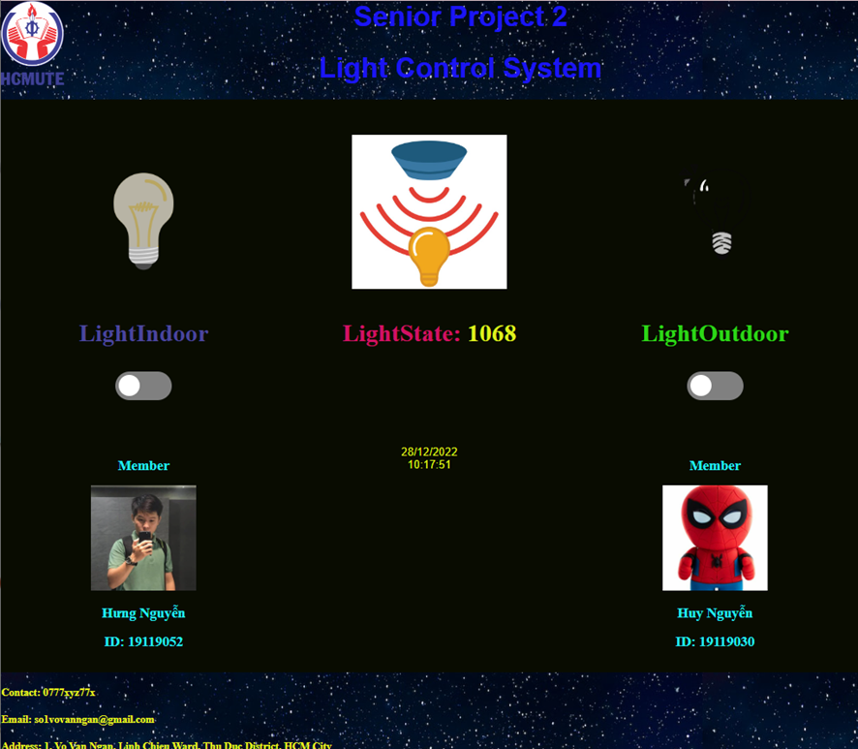
Website
CET K19
INDEX.HTML

Slide 16
Lighting Control System
CET K19
1. Introduction
2. System model
3. System design
4. Result
5. Conclusion and future work
INDEX.HTML

Slide 17
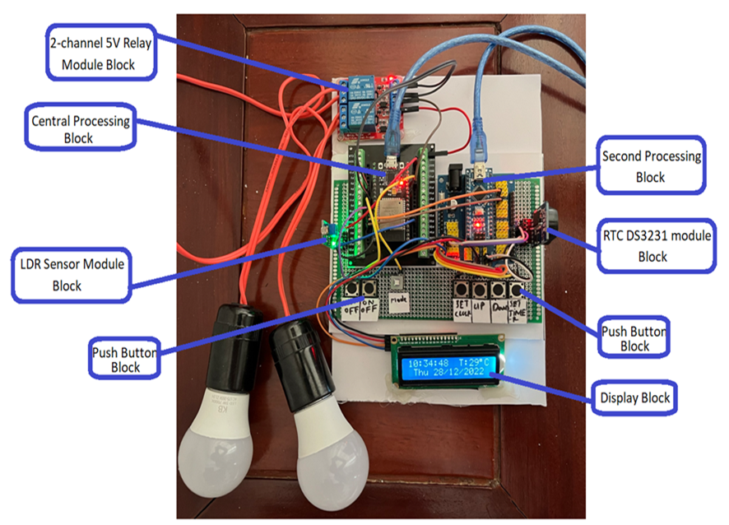
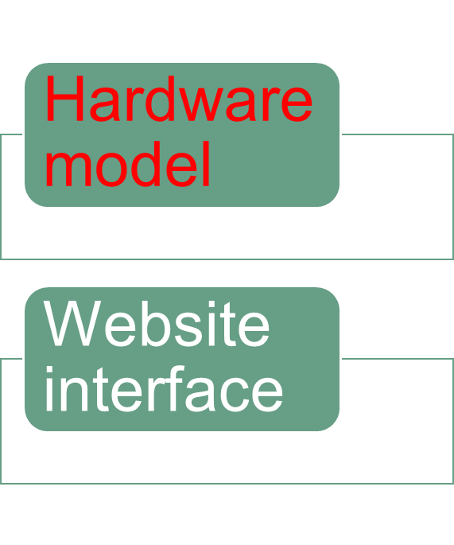

Results
CET K19
INDEX.HTML

Slide 18
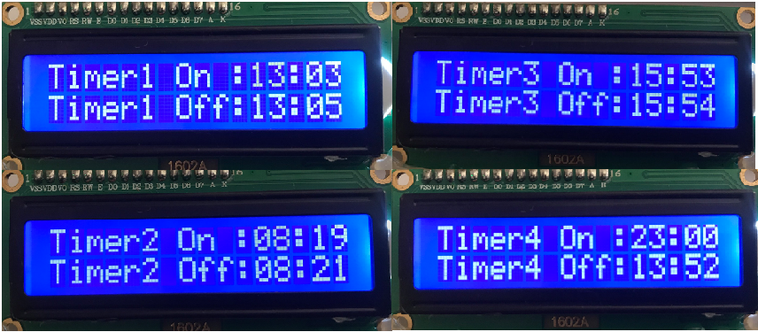
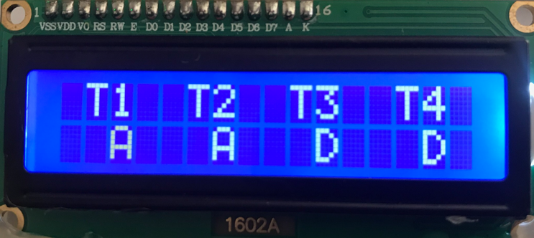
Results
CET K19
Timer options menu
Timer setting details
INDEX.HTML

Slide 19
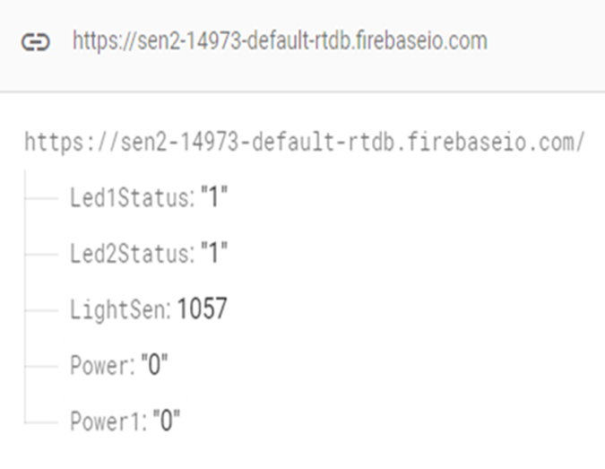
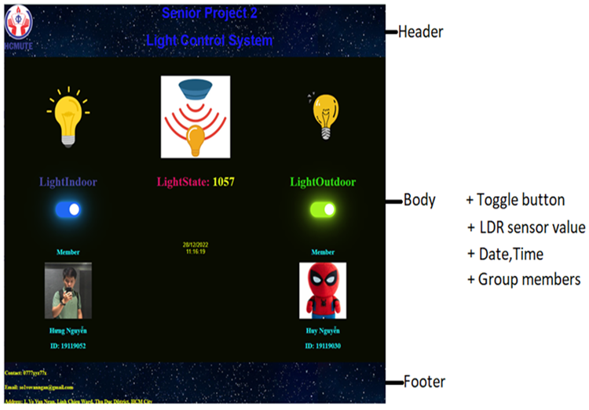
Website interface
CET K19
INDEX.HTML

Slide 20
Lighting Control System
CET K19
1. Introduction
2. System model
3. System design
4. Result
5. Conclusion and future work
INDEX.HTML

Slide 21
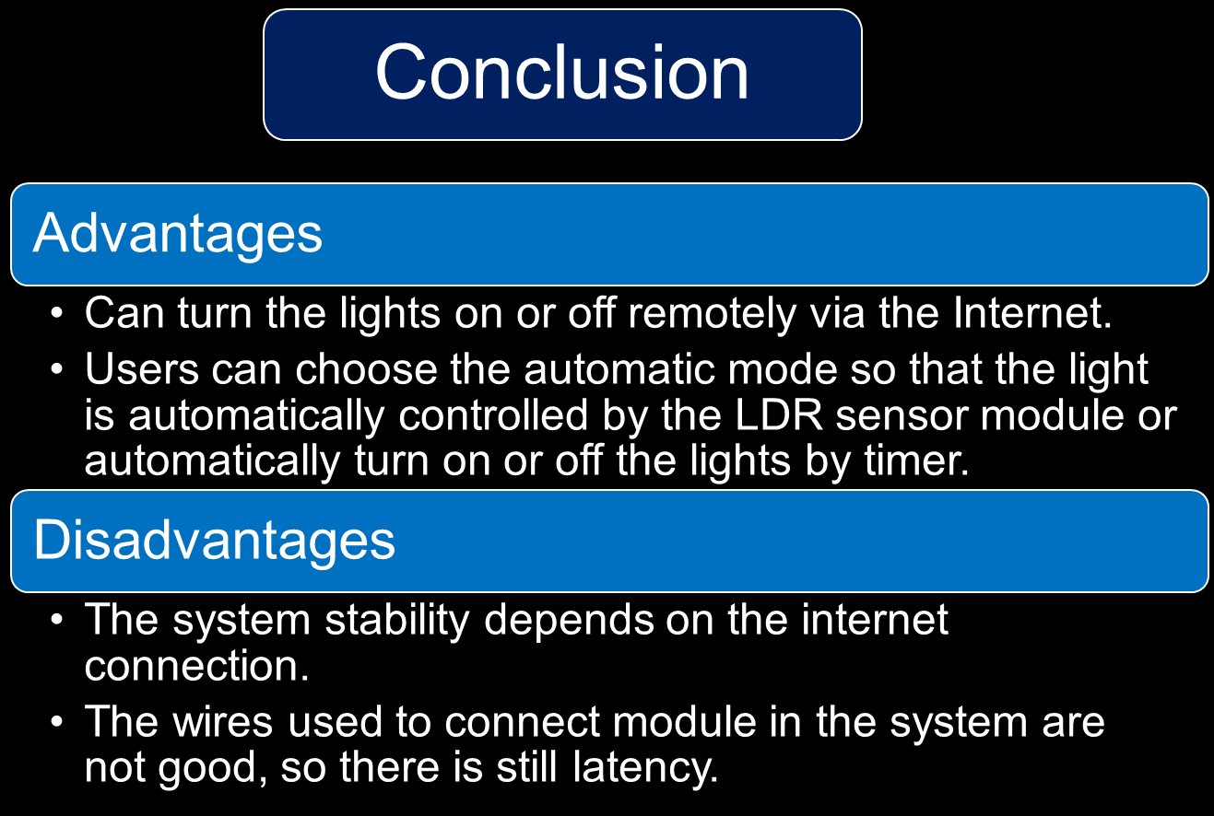
CET K19
INDEX.HTML

Slide 22
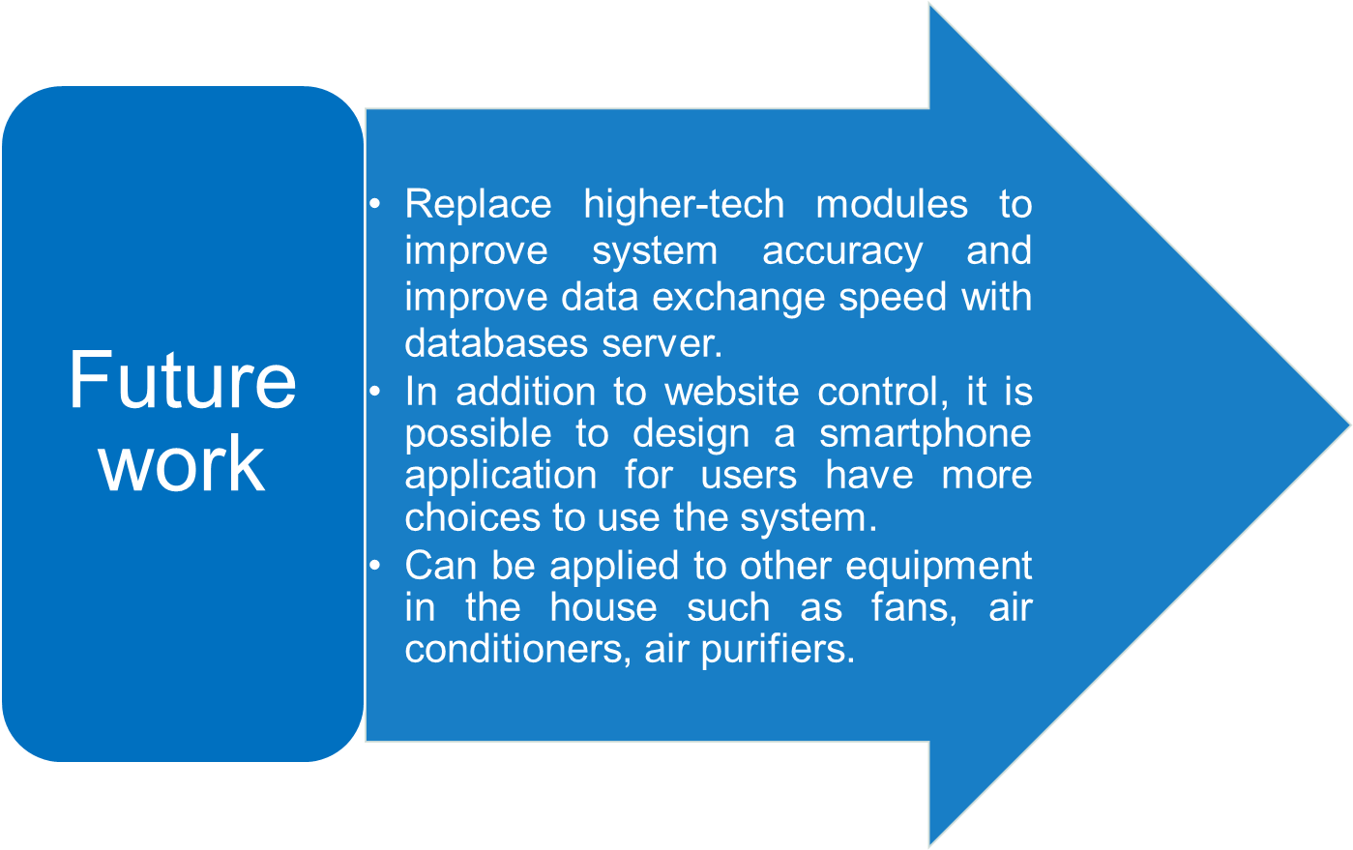
Conclusion and future work
CET K19
INDEX.HTML

Slide 23


